Slide 1



WELCOME TO OUR
PRESENTATION
MHP HUB
“Way To Success”:

Slide 2

Presented By
Back- end Engineer
Jannatul Mawa
ID-0222210005101135
Team Leader
Hammy Haricha Himu
ID-0222210005101077
Font - end Engineer
Puja Mazumder
ID-0222210005101055

Slide 3



Slide 4
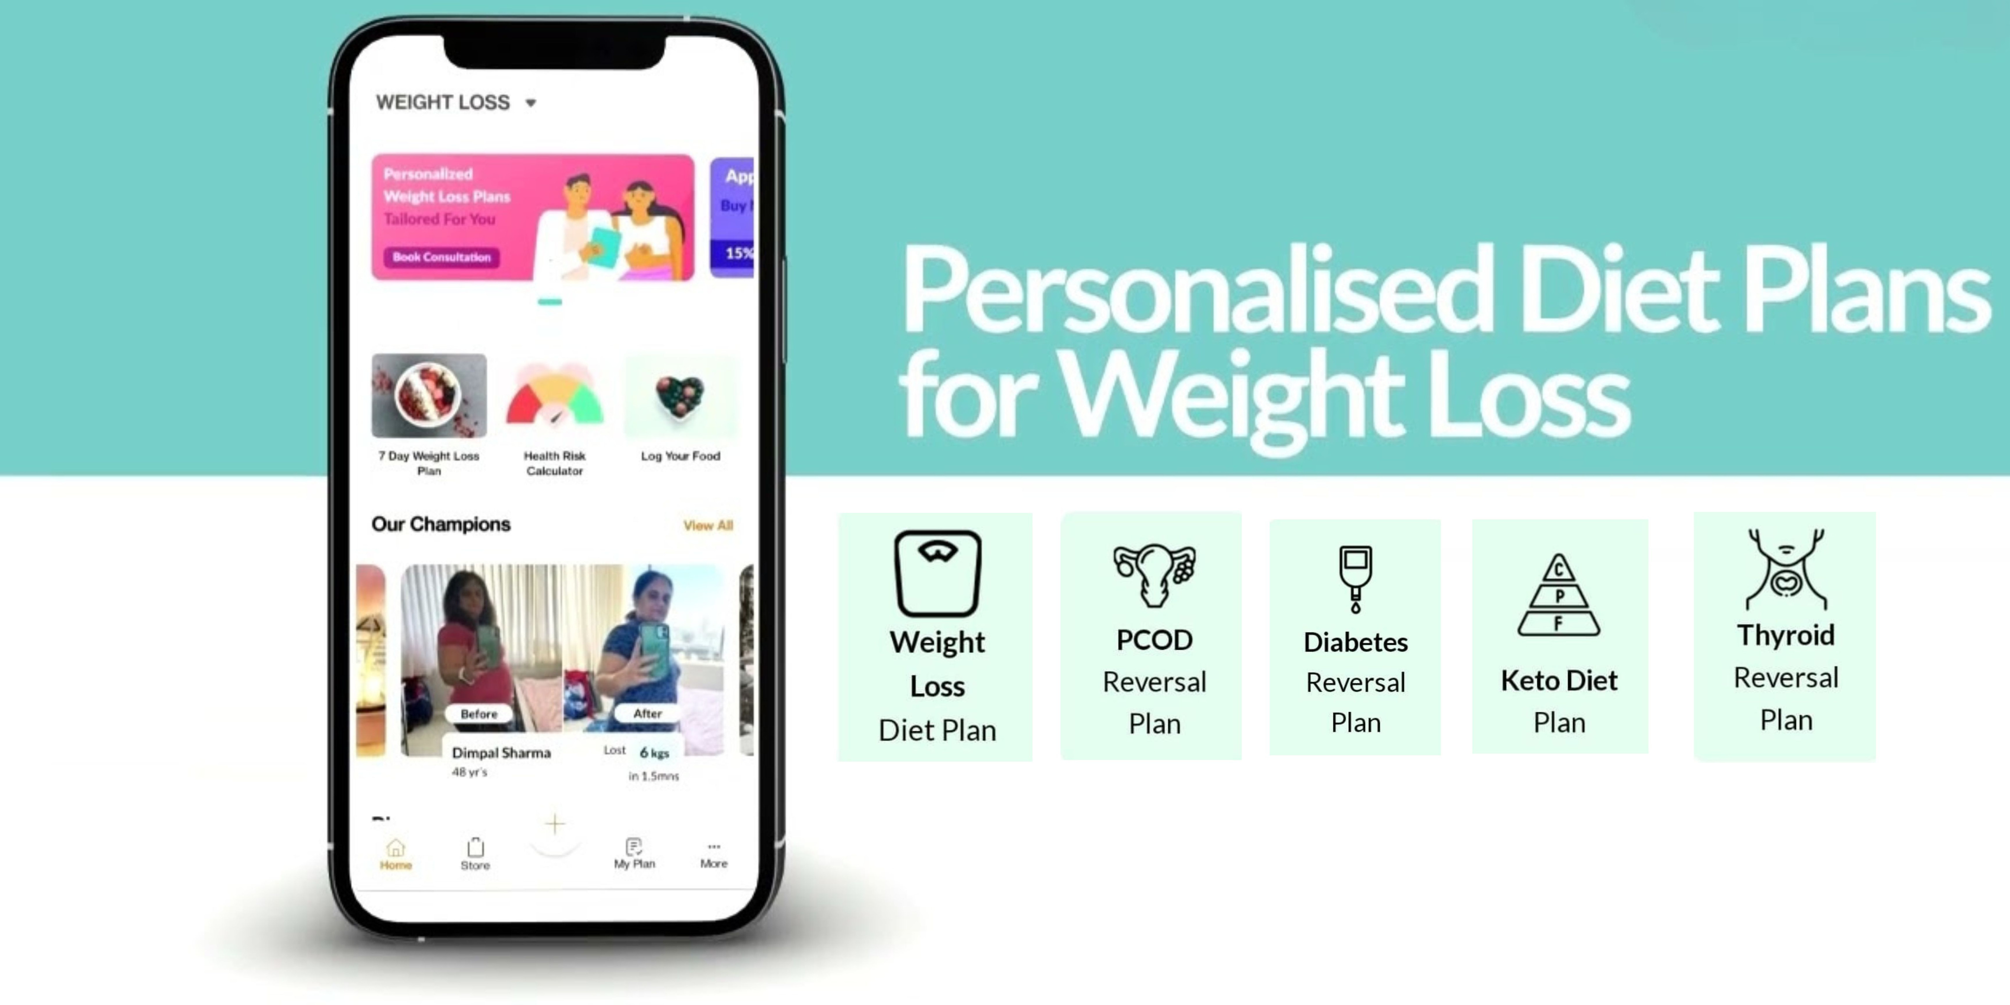
Livofy
At Livofy, We Provide:
Personalized Care Protocols.
Dietary Protocol Recommendation.
Lifestyle Changes.
Your paragraph text

Slide 5
INTRODUCTION
"A Healthy outside starts from the inside"
We all know Health is wealth. A healthy lifestyle can change your life. livofy helps us a lot to make this journey easy.
Now lets know about Livofy -
Livofy is one of largest Nutrition Consulting Company that helps clients with Weight Loss, and better manage their PCOS, Diabetes and Thyroid through a Personalized Diet Protocol

Slide 6
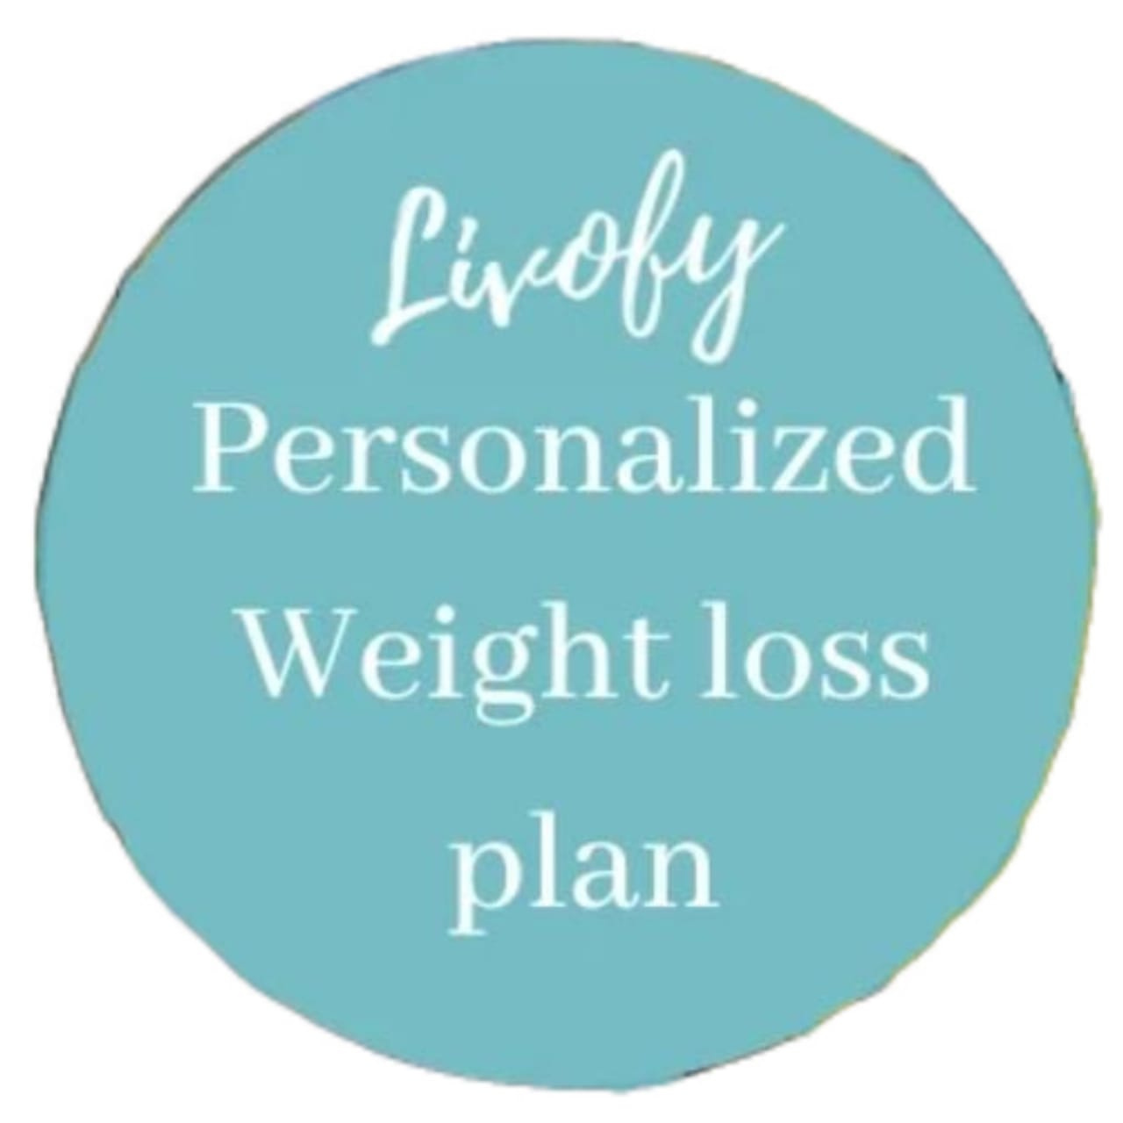
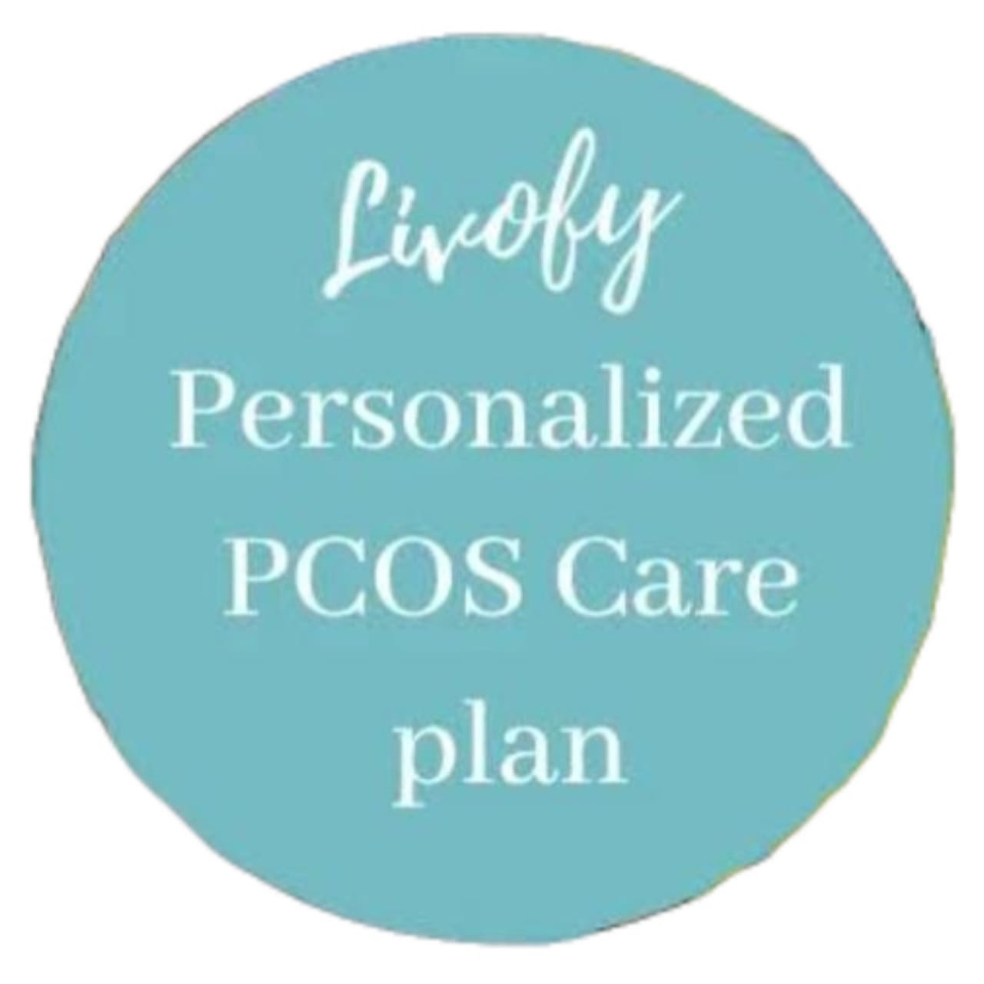
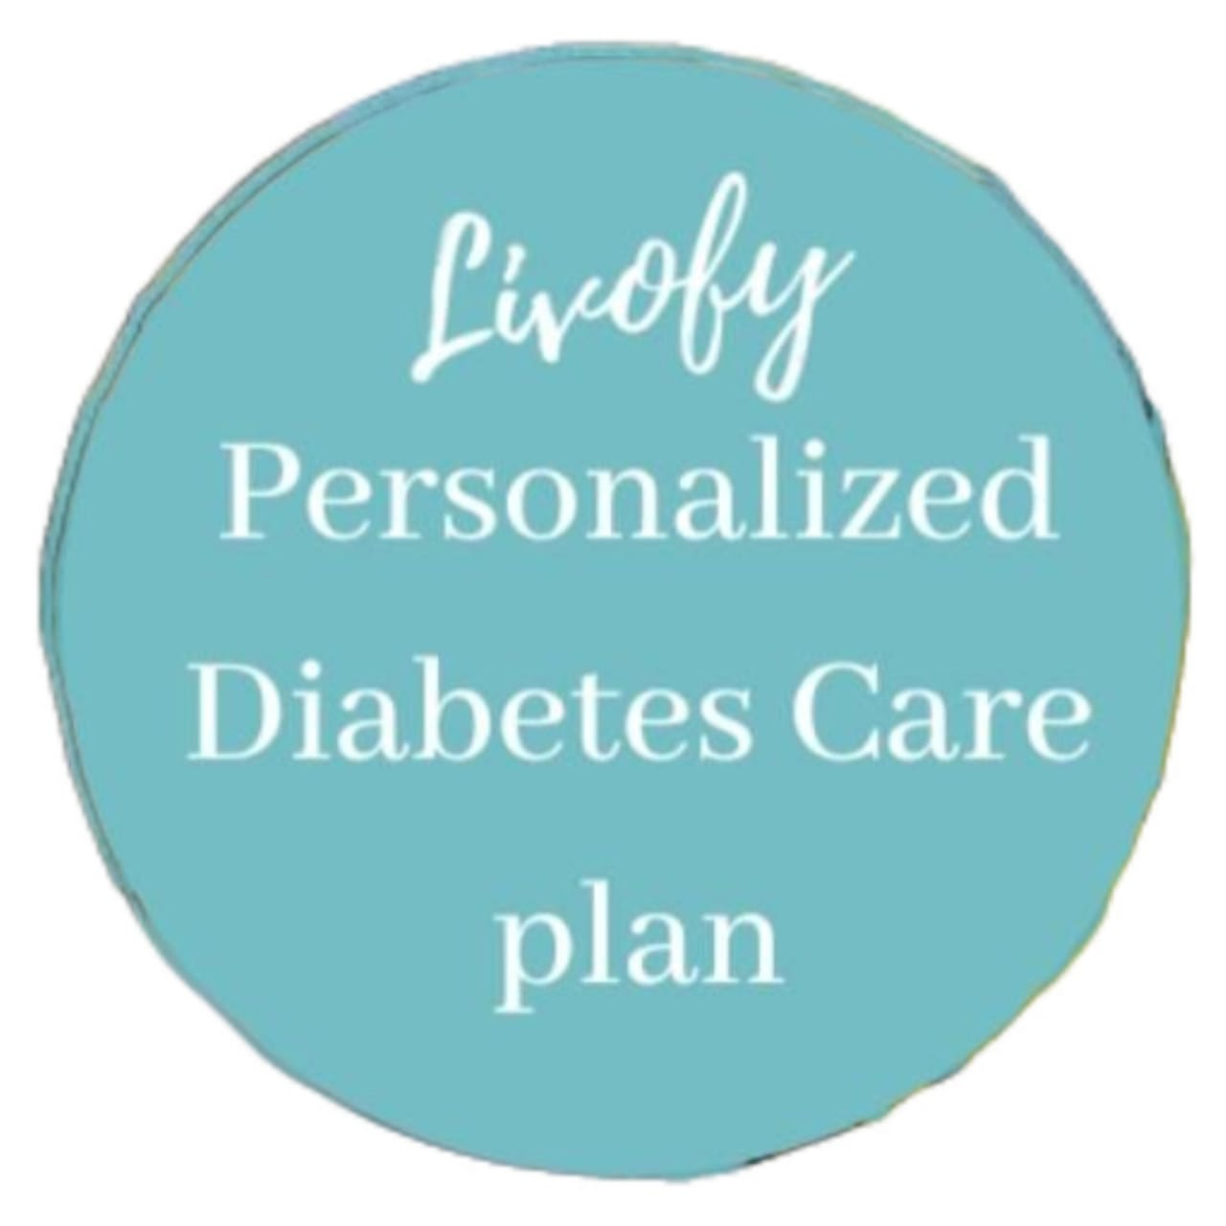
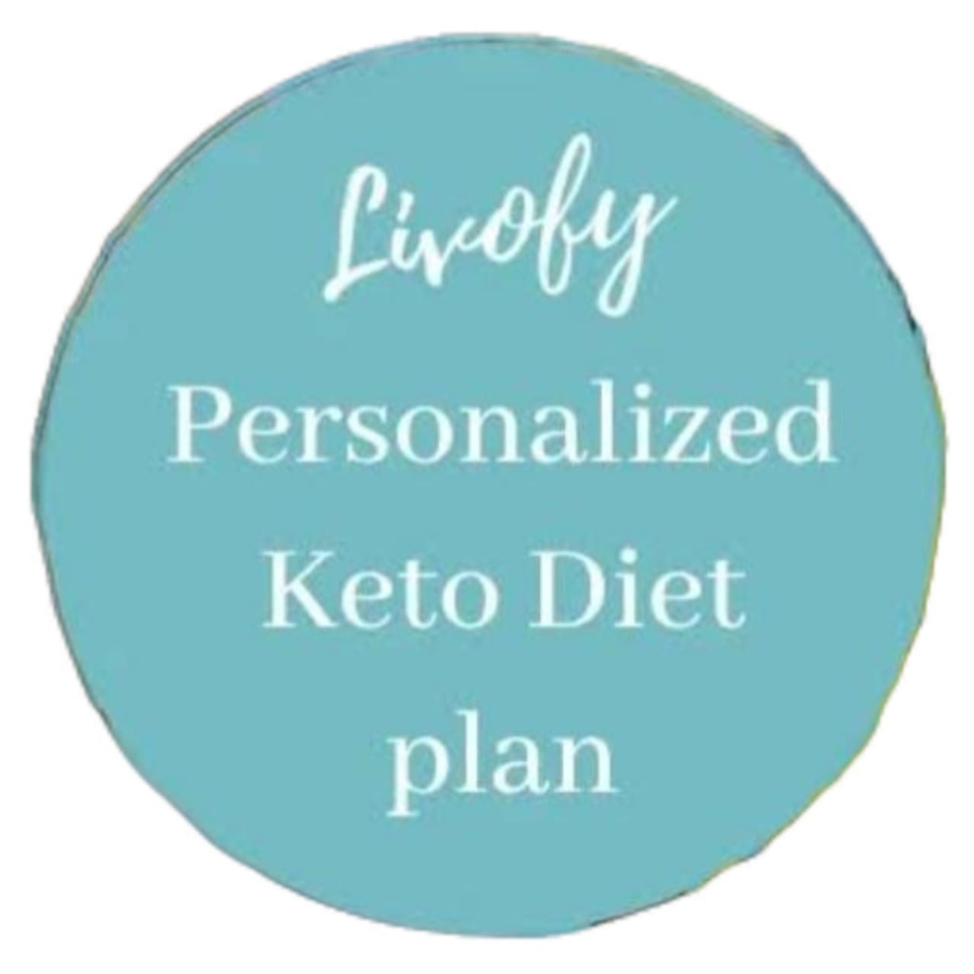
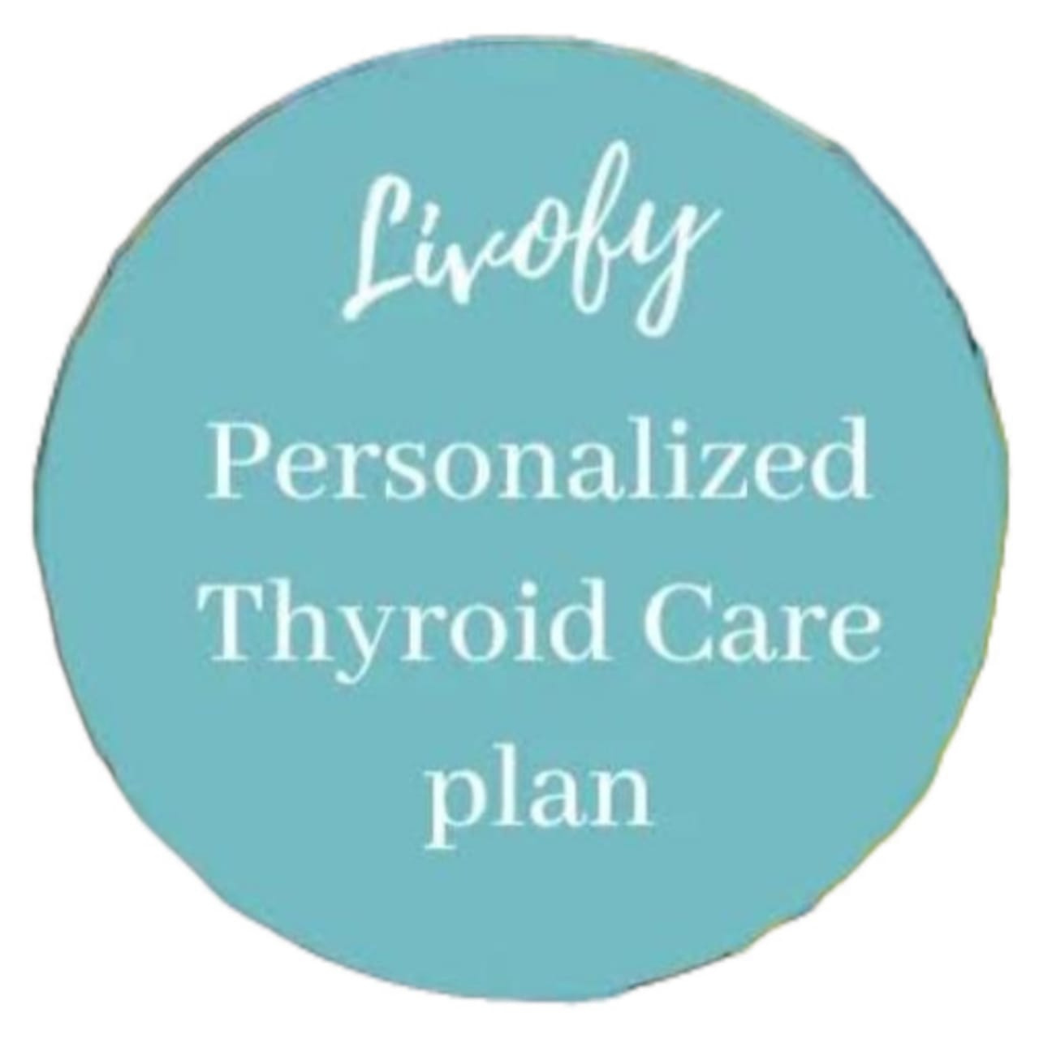
Livofy provide us ....

Slide 7
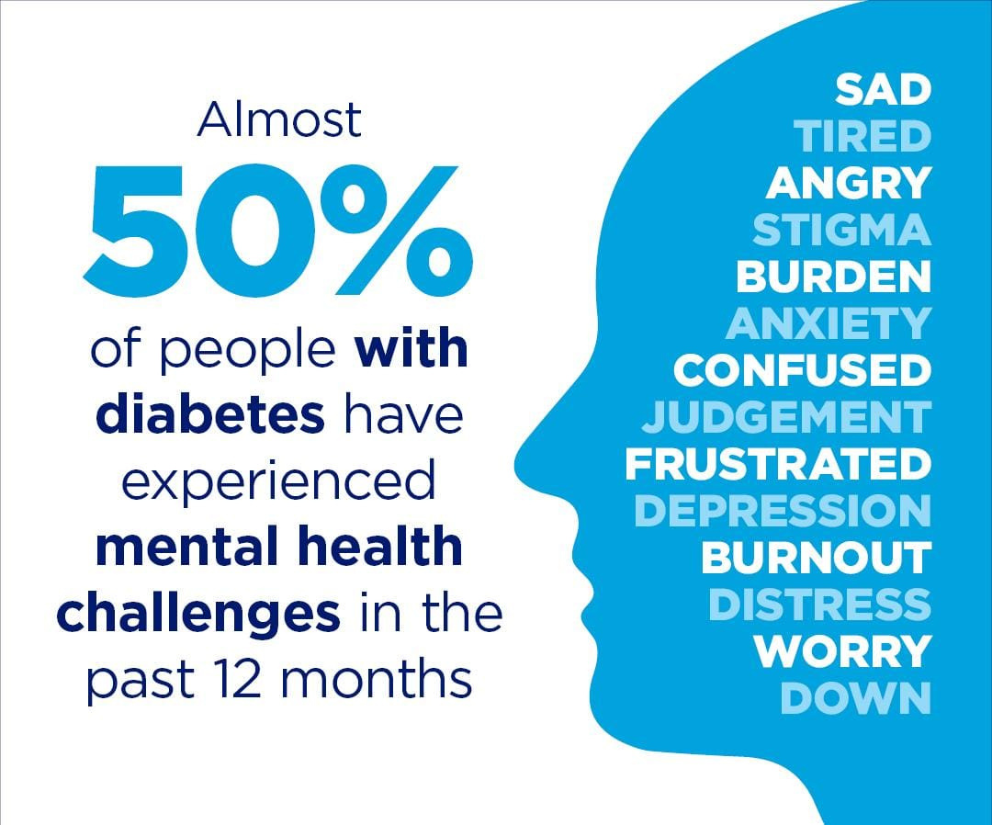
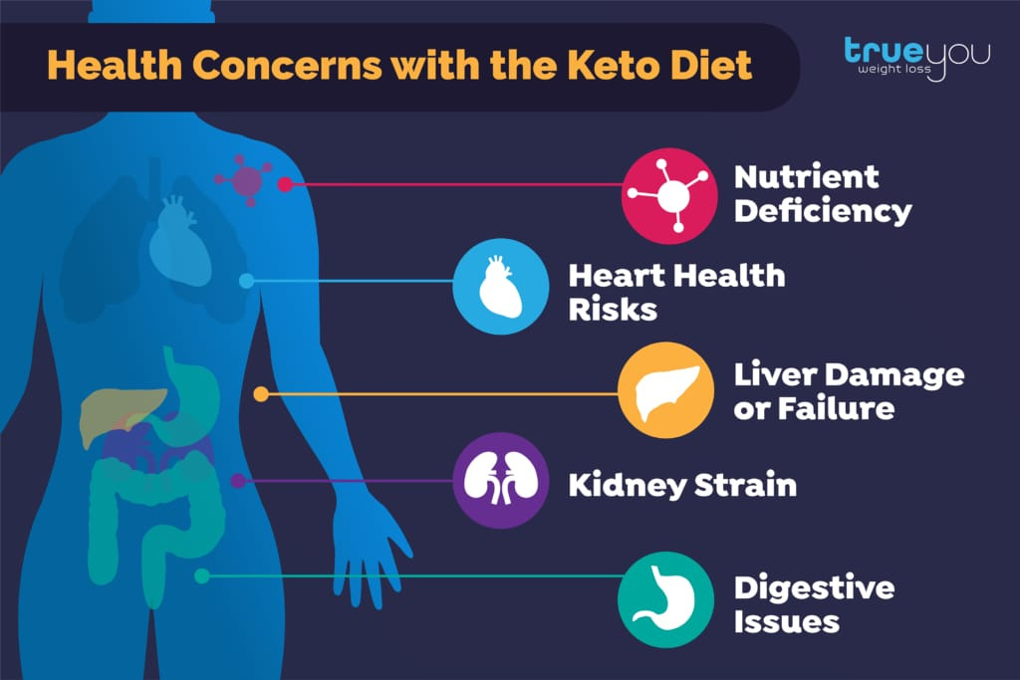
Livofy PROBLEM & SOLUTION
IN REAL LIFE BASED
Problems:
Diabetes->
Health Concerns with the keto Die:t
The keto diet could cause low blood pressure,
nutrient deficiencies ,
kidney stones,
Liver damage or failure,
Digestive Issues
and an increased risk of heart disease

Slide 8
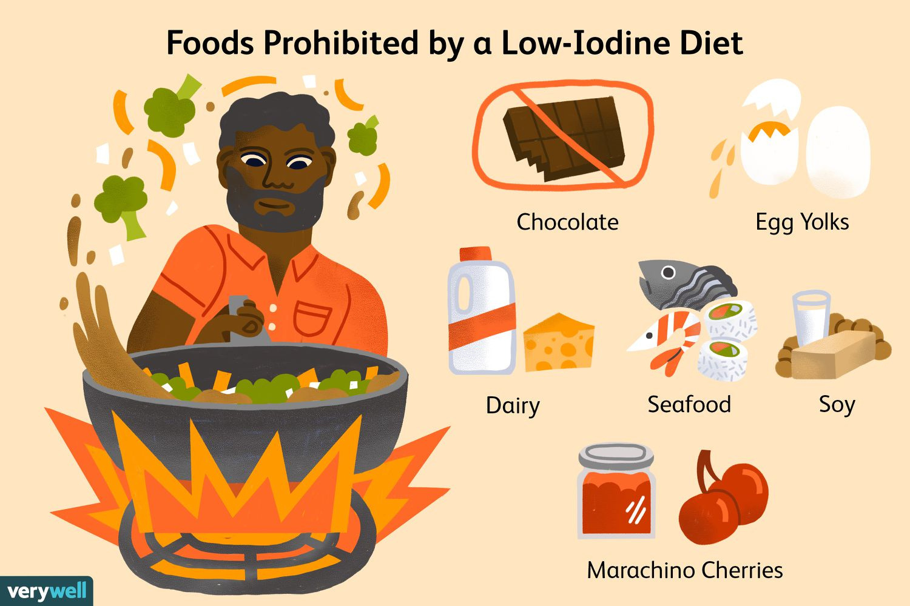
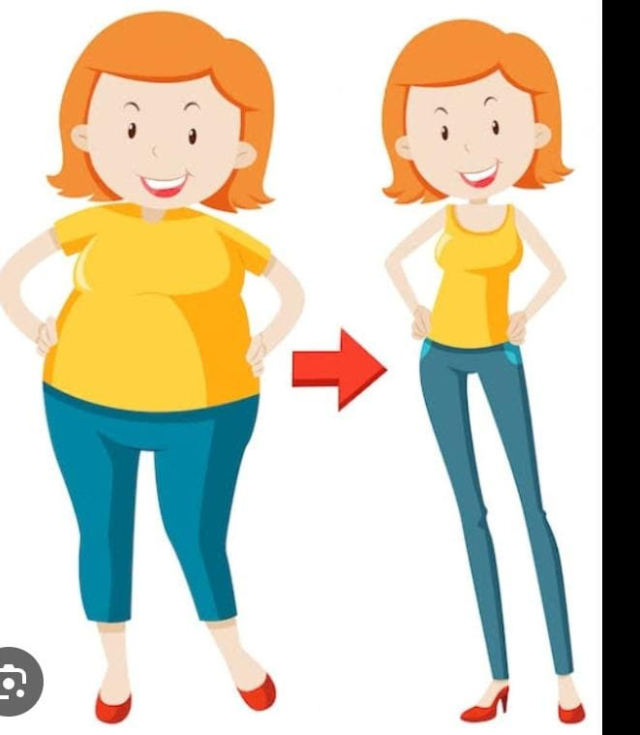
Thyroid:
Thyroid disease was estimate to 20.43% it is often a lifelong medical condition. It is caused by iodine deficiency
Weight Issues:
Around 17% of adult population in Bangladesh suffer from overweight, unhealthy diet plan, lack of exercise & genetics are the causes of weight issues

Slide 9
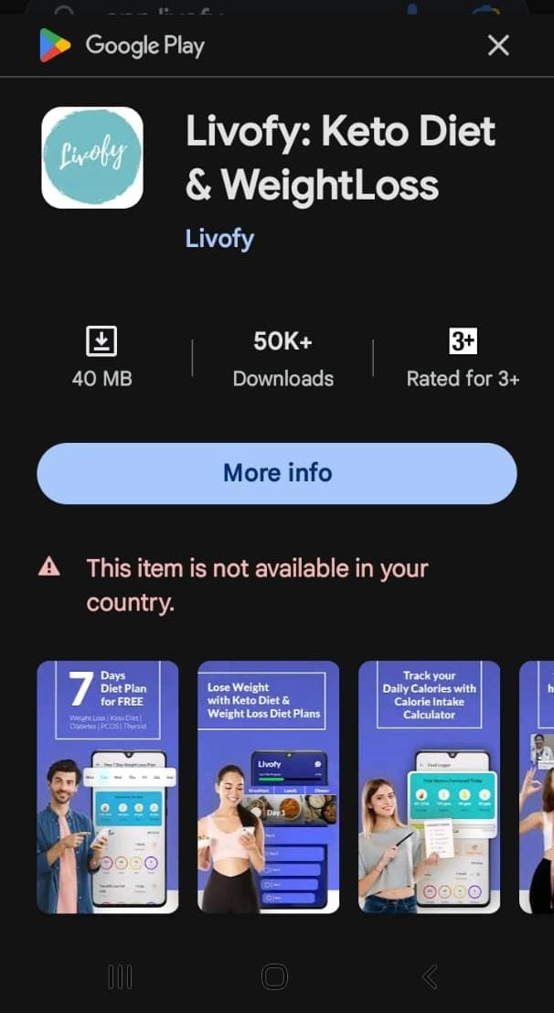
Last and one of the biggest problem of livofy is that this app is not available in our country , we can use it from browser

Slide 10
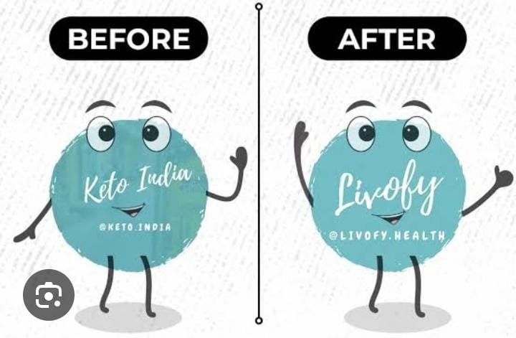
SOLUTIONS:
How to lose weight fastly?
Start weight training. ...
Build a better breakfast. ...
Skip sugary beverages. ...
Get moving. ...
Eat mindfully. ...

Slide 11
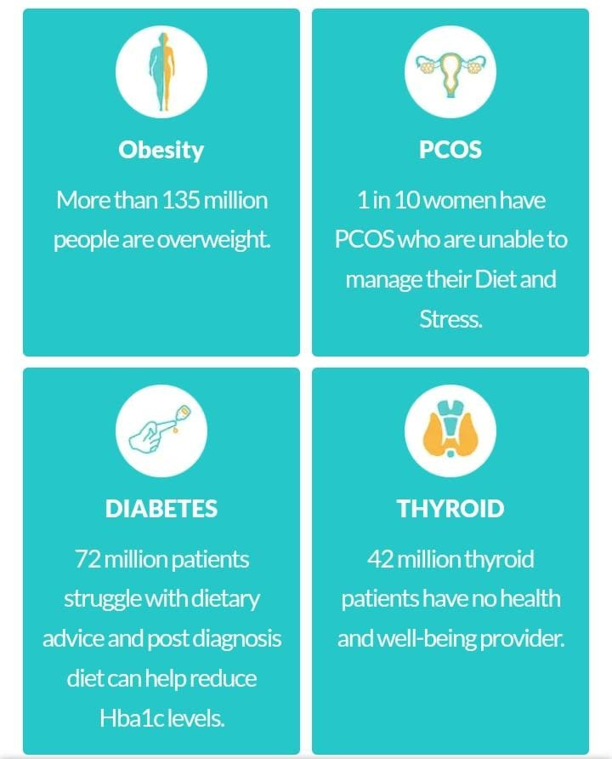
facing chronic issues like Weight gain, Diabetes, PCOS, and Thyroid which are because of a poor lifestyle and nutrition - and we at Livofy just aim to solve that for them.

Slide 12
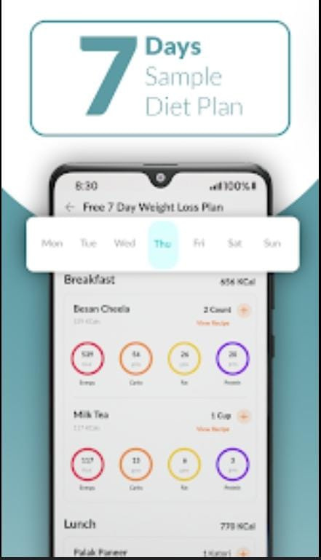
FEATURES
weight loss app & Keto Diet Plan:
New Features added in Livofy - Weight Loss App. This app include;
- 7 Days Free Diet Plan for Weight Loss in the weight loss app...
-Free 1000+ healthy Indian diet chart & keto diet plan in the healthcare app...
-Health Calculators for Weight Loss....

Slide 13

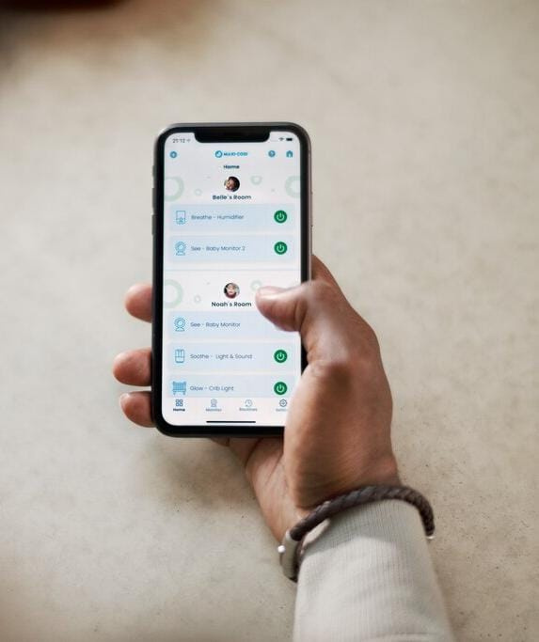
ADVANTAGE
By using Livofy app's we can get many benefits
We can get ideas about weight loss, diet plan, diabetes, thyroid through mobile at home

Slide 14

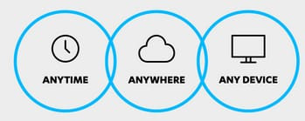
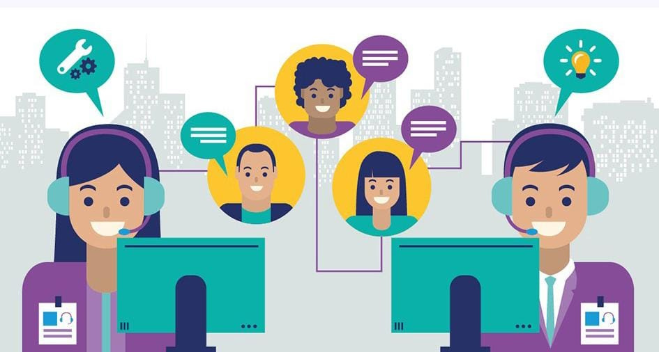
By using this app we can consult doctors at home.
We can use this
We can easily know about diet charts, health awareness in less time through chat and call

Slide 15
ANY
QUESTION?

Slide 16

THANK YOU
join us Revolutionizing Health Care by Livofy

